Slide 1
Annotations

Slide 2
Introduction
Annotations are used to provide supplemental information about a program.
Annotations associate meta-information with definition.
They can be attached to any variable ,method ,expression or other program element.

Slide 3
Annotations start with ‘@’.
Annotations do not change the action of a compiled program.
Annotations help to associate metadata (information) to the program elements i.e. instance variables, constructors, methods, classes, etc.

Slide 4
Spring Boot Annotations
@Auto-configuration- @Auto-configuration such as checking for the dependencies , the presence of certain classes in the class path the existence of a bean , or the activation of some property.
An opinionated approach to configuration, It provide alternative of the annotation I.e @SpringBootApplication.
@SpringBootApplication- This annotation is used to mark the main class of a Spring Boot application.
@SpringBootApplication=@ComponentScan+@EnableAutoConfiguration+@Configuration.

Slide 5
Spring MVC and REST Annotations
@RestController: It can be considered as a combination of @Controller and @ResponseBody annotations. The @RestController annotation is itself annotated with the @ResponseBody annotation. It eliminates the need for annotating each method with @ResponseBody.
@GetMapping: It maps the HTTP GET requests on the specific handler method. It is used to create a web service endpoint that fetches It is used instead of using: @RequestMapping(method = RequestMethod.GET).

Slide 6
@RequestParam: It is used to extract the query parameters form the URL. It is also known as a query parameter(? _variable1_ & _variable2_ ). It is most suitable for web applications. It can specify default values if the query parameter is not present in the URL.
@PathVariable: It is used to extract the URI parameter(eg: /_varaible_/value1?value2) from the URL. It is most suitable for the RESTful web service, where the URL contains a path variable. We can define multiple @PathVariable in a method.

Slide 7
@PostMapping: It maps the HTTP POST requests on the specific handler method. It is used to create a web service endpoint that creates It is used instead of using: @RequestMapping(method = RequestMethod.POST)

Slide 8
Structure:
package com.example.demo;
Import configuration ;
Import bean;
@configuration
public class AppConfig { @Bean public datatype declaration{ return statement; } }

Slide 9
@Configuration (@RestController):We apply this annotation on classes. When we apply this to a class, that class will act as a configuration by itself
@Bean(@GetMapping):It creates Spring beans and generally used with @Configuration.
@Configuration (we can call it as a Configuration class) will have methods to instantiate objects and configure dependencies. Such methods will have @Bean annotation.

Slide 10
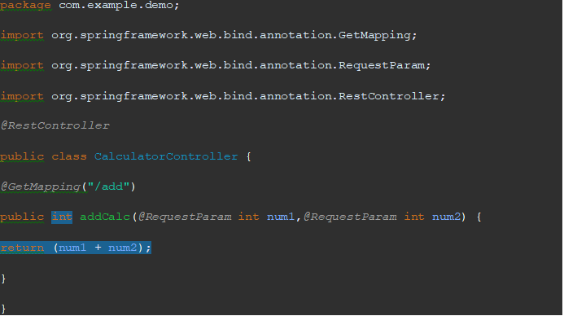
Example

Slide 11
Reference:
https://www.javatpoint.com/spring-boot-annotations
https://www.geeksforgeeks.org/spring-boot-annotations/
https://javatechonline.com/spring-boot-annotations-with-examples/

Slide 12

Thank You

